Slide 1
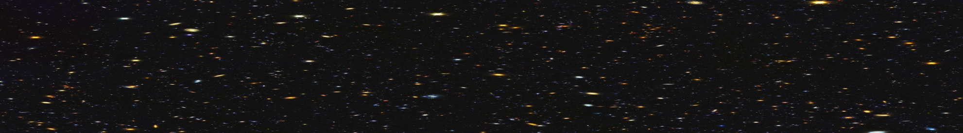
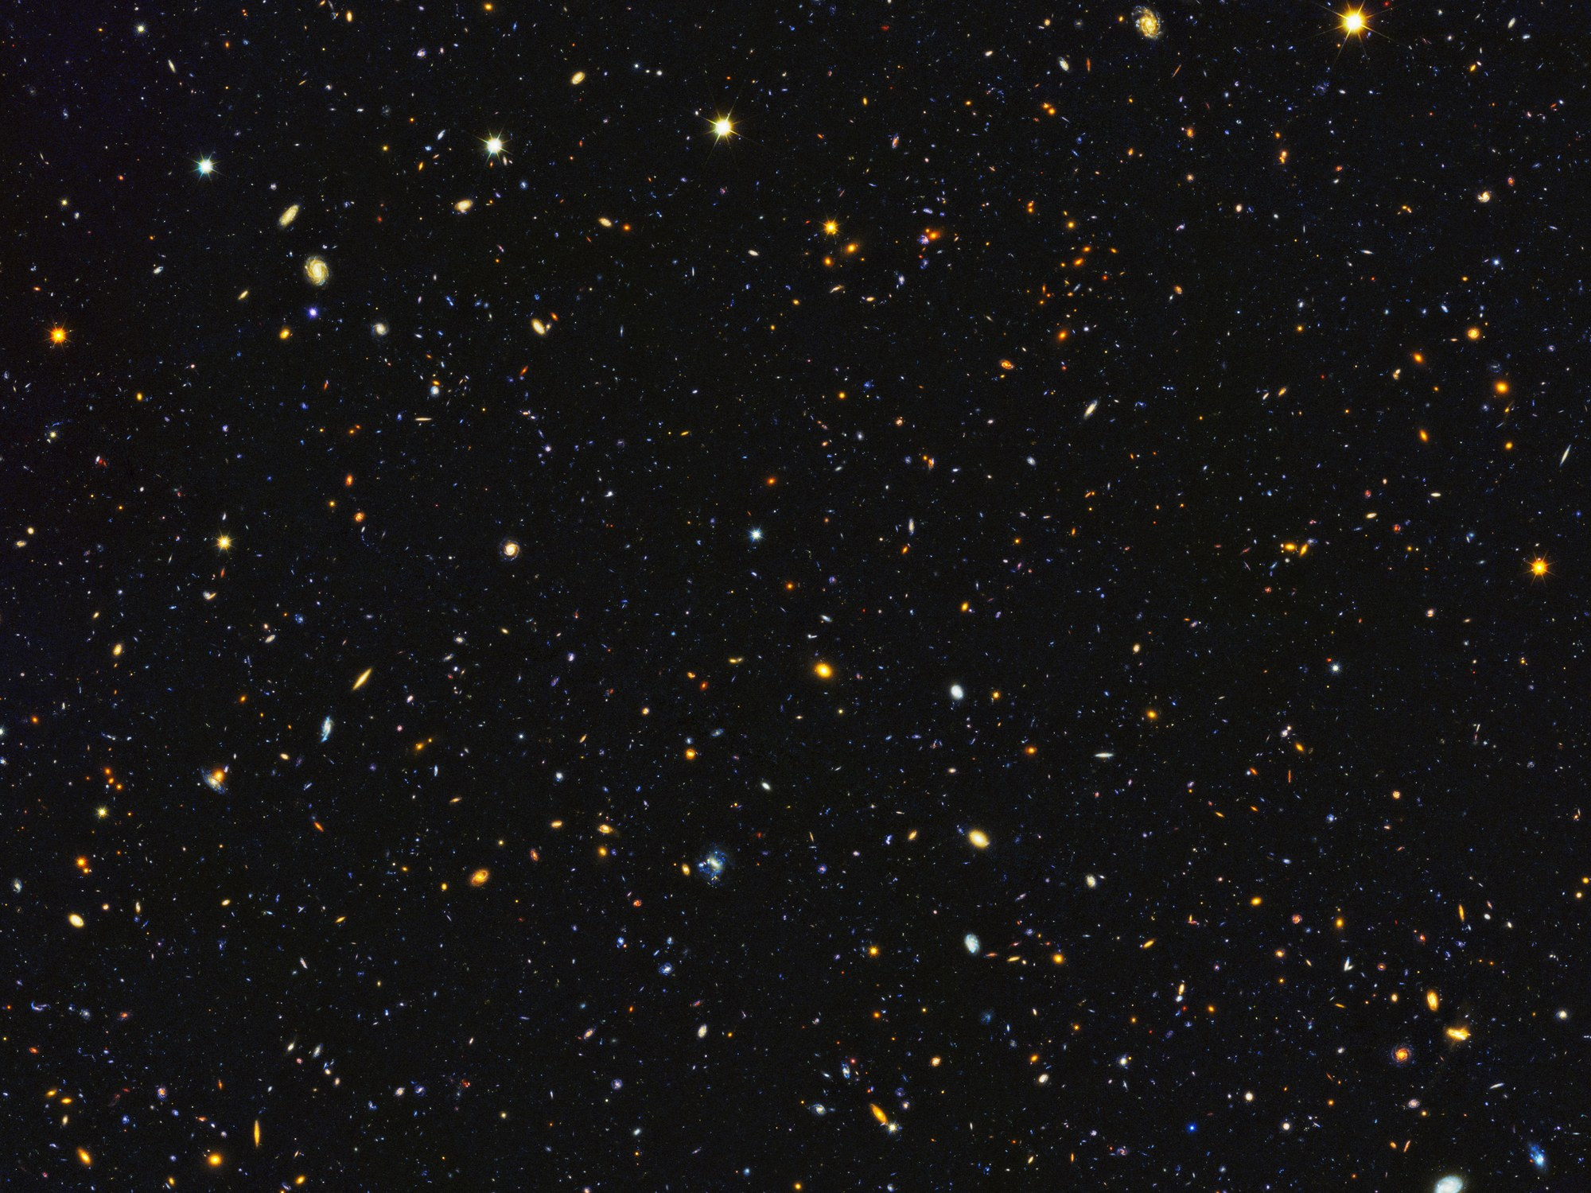
NASA SPACE APPS CHALLENGE
A Universe of Beauty and Wonder
On the Shoulders of the Giants

Slide 2
Our job:
To design and prototype:
A Card Game

Slide 3
Our aim:
To make a change in card games.
To give people information about the space.
To have fun while you learn new information.

Slide 4
Our game:
Hubble Trouble

Slide 5
Description and design of our card game:
A competitive game
Two players up to four players
40 cards
10 images (repeated 4 times)
Each card has a certain power. The power scale is from 2000-5000.
Each a card has a title of card ID up-right the image.
Lovely short information about the image
The power considers science, beauty and inspiration

Slide 6
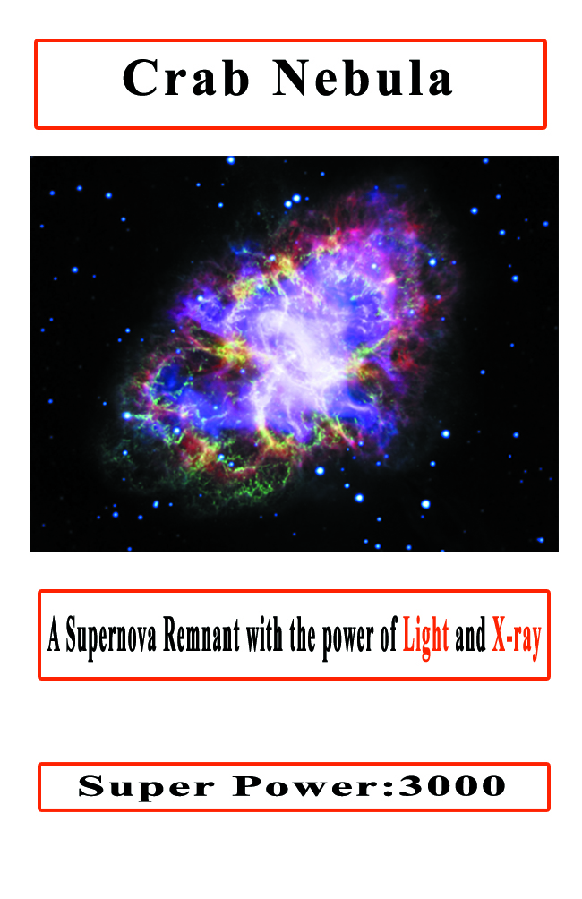
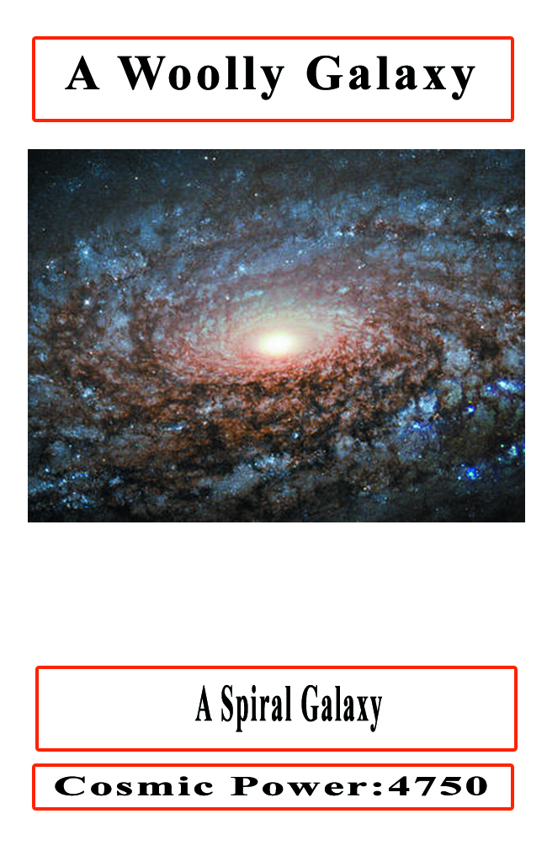
Sample of the Cards

Slide 7
Rules of the game:
- Each player will have FOUR cards
- Each of the players will put one card on the table(covered).
- Then, they UNCOVER all cards
- The owner of card with the higher power wins the cards
- Then the players put another card until they run out of the four
cards of the turn.
- Other FOUR cards to be distributed to them until the game
ends.
- At the end of the game, the winner is the one who wins more
cards.

Slide 8
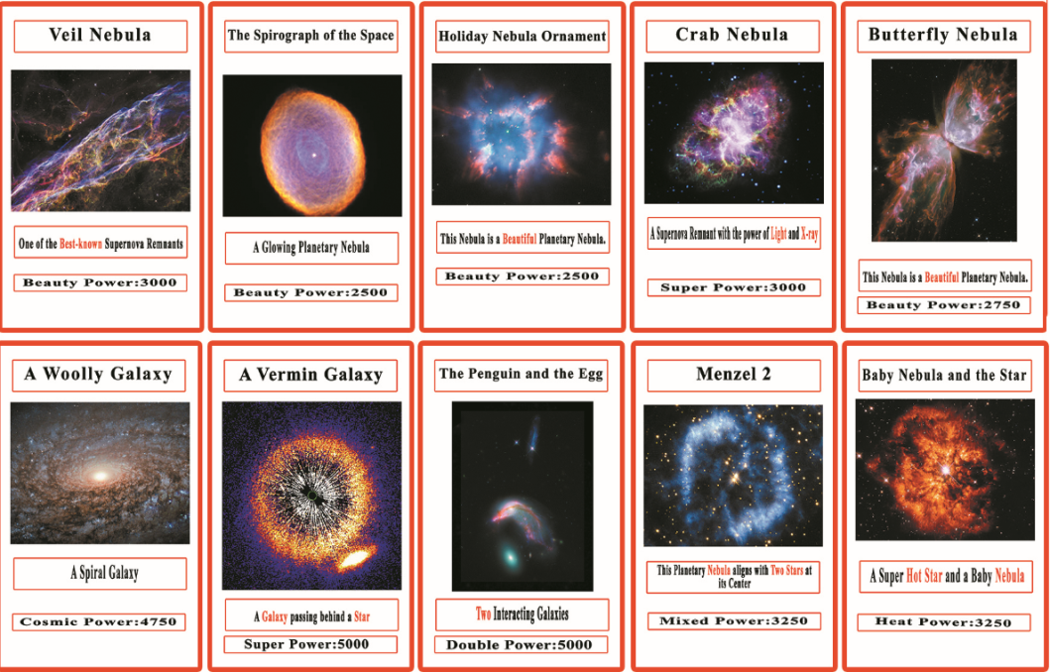
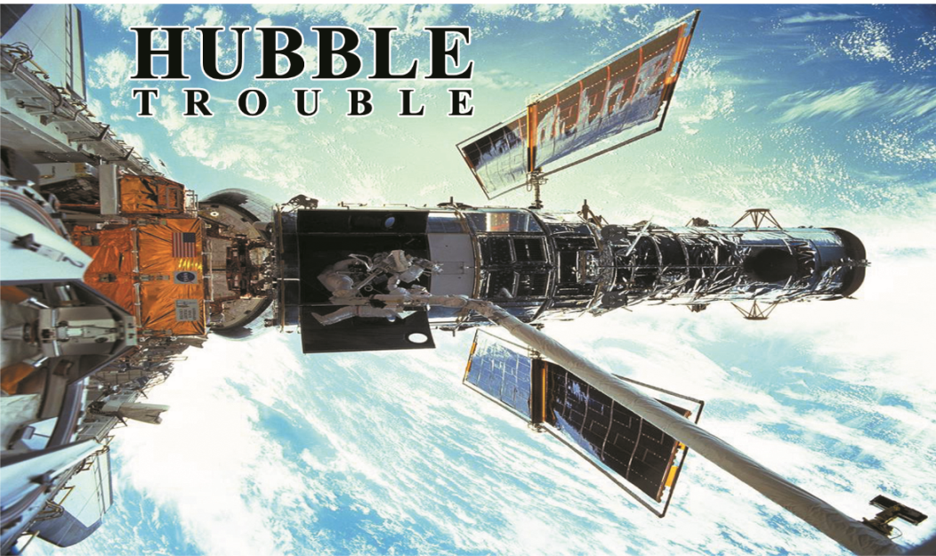
Double game, double fun:

Slide 9
Thank you

